Slide 1


Project Review-1
(Semester VII)
Vivekanand Education Society's Institute of Technology
An Autonomous Institute Affiliated to University of Mumbai
Title of Project : Electric energy consumption monitoring on daily basis for households in a society
Group Name : code-o-philes
1. Anshkumar Agrahari - 01 (D19B)
2. Akash Neharkar - 40 (D19B)
3. Khushi Purohit - 51 (D19B)
4. Tejas Sharma - 55 (D19B)
Name of Mentor : Prof. Dr. Nadir Charniya
16-07-2024
Project Review 1 : EXTC

Slide 2
Contents to be covered
Problem Statement
Literature Survey
Research Gaps
Proposed Solution
Complete Block Diagram of Proposed System
Methodology
Components requirement
Time Chart
Idea Competition
Results
Conclusion
References
16-07-2024
Project Review 1 : EXTC

Slide 3
List the suggestions given with abstract approval
Continuous recording/hourly dumping on cloud could be costly.
To look for an efficient way to dump data daily or weekly.
As a solution for managing data transmission and storage costs, we will implement Scheduled Data Uploads. The system will be configured to upload data at specified intervals, such as daily or weekly, rather than continuously. This approach will significantly reduce cloud storage and transfer costs.
16-07-2024
Project Review 1 : EXTC

Slide 4
Problem Statement
In residential communities, households often struggle with effectively monitoring and managing their electricity consumption due to the limitations of traditional energy meters, which only provide monthly data usage. This infrequent reporting makes it challenging for residents to make timely adjustments to their energy habits, hindering efforts to reduce energy consumption, lower utility bills, and promote energy efficiency.
16-07-2024
Project Review 1 : EXTC

Slide 5
Literature Survey
Sr. No. | Title of Technical paper[citation] | Name of Author | Year of publication | Name of Journal | Methodology | Results/ Conclusions | Drawbacks/ Limitations
1. | IoT Based Smart Digital Electric Meter for Home Appliances[1] | Lekhika Chettri, Tshering Kiden Bhutia, Mayalmit Lepcha,Ayodeji Olalekan Salau | 2020 | International Conference on Decision Aid Sciences and Application | This project involves designing a Digital Electric Meter. Using an Arduino UNO microcontroller, ACS712 current sensor, and ESP8266 WiFi module to monitor energy usage of AC appliances in a home environment. | Instead of the manual collection of the readings of the power consumption of electrical appliances used in the home, the developed system offers an easier and accessible way. The data is collected through an internet of things architecture framework. | The system may face challenges in scalability for larger or more complex installations with numerous appliances.
16-07-2024
Project Review 1 : EXTC

Slide 6
Literature Survey
Sr. No. | Title of Technical paper[citation] | Name of Author | Year of publication | Name of Journal | Methodology | Results/ Conclusions | Drawbacks/ Limitations
2. | Implementation of advanced electric metering and billing system on Arduino using Artificial Neural Networks[2] | Suhas N, Sandesh B P,Manoj K B, Kishore S, Shilpa R, Mahadevaswamy | 2021 | International Journal of Engineering Research & Technology | In this project, a camera is used to capture photos of electrical meters, which are processed in MATLAB R2017a to extract the readings using an ANN. Calculations are then performed to determine the electricity bill, which is sent via SMS using a GSM module. | The proposed paper successfully recognizes readings from both analog and digital meters, eliminating human intervention in the electricity metering and billing process. By sending the bill amount via SMS using a GSM module, it also removes the risk of losing the bill. | Using Arduino gives challenges related to processing power, memory constraints, interface complexity, and software limitations.
16-07-2024
Project Review 1 : EXTC

Slide 7
Literature Survey
Sr. No. | Title of Technical paper[citation] | Name of Author | Year of publication | Name of Journal | Methodology | Results/ Conclusions | Drawbacks/ Limitations
3. | Real Time & Automated Meter Reading using Image Processing Reducing Human Error[3] | Rahul Vemuri, Viraj Sapte, Jim Cheriyan,Rishabh Maniyar, Dr. Abhay Kshirsagar | 2022 | International Research Journal of Engineering and Technology | The project uses a webcam connected to a Raspberry Pi to capture images of energy meters at regular intervals. Images are uploaded to Firebase Realtime Database for storage. Data extraction is performed using the EasyOCR Python library. | This project utilizes Node-RED along with Google Vision API. Google Vision API is most efficient OCR recognition tool, delivering impeccable accuracy across a variety of utility meters. | Utilizing Google Vision API for OCR incurs costs based on usage, which could become prohibitive for large-scale or continuous monitoring applications.
16-07-2024
Project Review 1 : EXTC

Slide 8
Research Gaps
Existing challenges in scalability, image distortion due to shadows and non-uniform illumination, and potential cost constraints with Google Vision API for OCR in electricity meter reading applications.
Research gap in comprehensive solutions integrating robust image processing techniques, such as adaptive thresholding and contour detection, with efficient and cost-effective OCR algorithms for embedded systems like Raspberry Pi.
Opportunity to develop and demonstrate a scalable, accurate, and cost-efficient solution for real-time electricity meter reading and monitoring.
Solution suitable for both small-scale residential and large-scale industrial applications.
16-07-2024
Project Review 1 : EXTC

Slide 9
Proposed Solution
By implementing a daily energy consumption monitoring system, households in a residential society will gain access to precise and actionable information about their energy usage. This approach addresses the gap left by traditional monthly billing systems and empowers residents to adopt energy-efficient practices.
Utilizing Existing Infrastructure: No need to implement new designs, making the system cost-effective and easy to adopt.
Detailed Daily Consumption Reports: Users receive daily updates on their energy usage.
User-Friendly Analytics Dashboard: A platform for visualizing and understanding energy consumption trends.
16-07-2024
Project Review 1 : EXTC

Slide 10
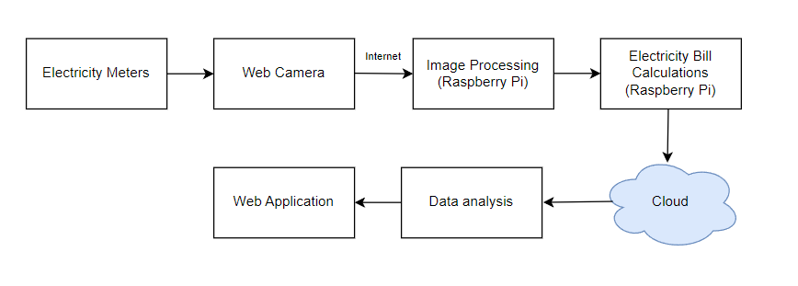
Complete Block Diagram of Proposed System
Fig. 1. Block Diagram Proposed System
16-07-2024
Project Review 1 : EXTC

Slide 11
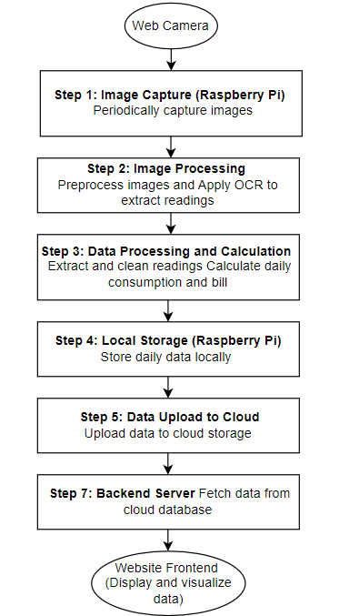
Flow Diagram
Fig. 2. Flow Diagram of Proposed System
16-07-2024
Project Review 1 : EXTC

Slide 12
Proposed Project Components and Expenditure
Hardware:
Sr. No | Component name | Cost
1. | Raspberry pi-5 | INR 1000/-
2. | Webcam | INR 1000/-
Software:
Sr. No | Software name | Cost
1 | VS Code | Free
Table 1. Components and Expenditure for Proposed System
16-07-2024
Project Review 1 : EXTC

Slide 13
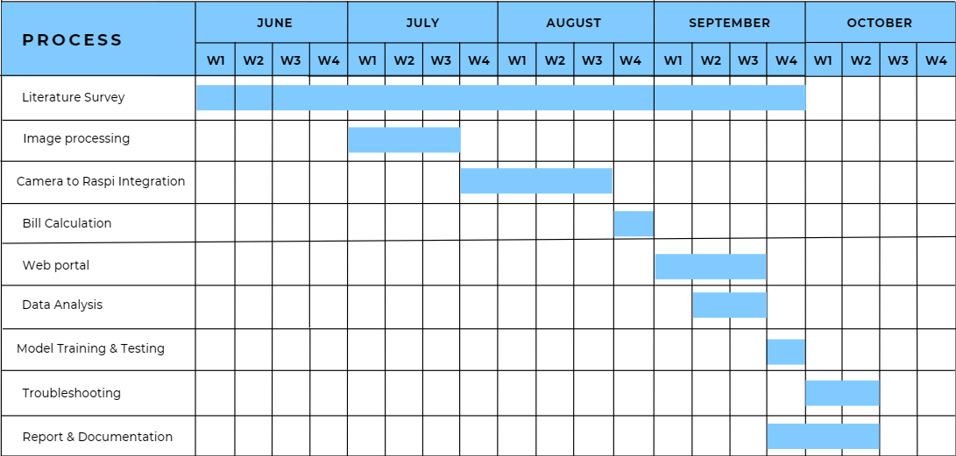
Time Chart
16-07-2024
Project Review 1 : EXTC

Slide 14
Results
This slide is optional for review 1
16-07-2024
Project Review 1 : EXTC

Slide 15
Idea Competition
Secure Meters Ltd.: They focus on features like tamper detection and data security, crucial aspects for the Indian market. Additionally, they might offer meters with integrated communication modules optimized for Indian network conditions.
Genus Power Infrastructure Ltd.: Their meters can boast of advanced functionalities like multi-tariff metering (enabling time-based pricing) or power quality monitoring. They also highlight features catering to the specific needs of Indian consumers, like prepaid functionality or integration with local payment systems.
Honeywell India: Leveraging their global expertise, Honeywell offer meters with cutting-edge technologies like advanced analytics or mesh networking capabilities. Additionally, they could emphasize robustness and reliability for harsh Indian weather conditions.
16-07-2024
Project Review 1 : EXTC

Slide 16
References
[1] A. O. Salau, L. Chettri, T. K. Bhutia and M. Lepcha, "IoT Based Smart Digital Electric Meter for Home Appliances", 2020 International Conference on Decision Aid Sciences and Application (DASA), Sakheer, Bahrain, 2020, pp. 708-713, doi: 10.1109/DASA51403.2020.9317062.
[2] Suhas N,Sandesh B P,Manoj K B, Kishore S,Shilpa R and Mahadevaswamy, “Implementation of advanced electric metering and billing system on Arduino using Artificial Neural Networks”, International Journal of Engineering Research & Technology, 2021.
[3] Rahul Vemuri, Viraj Sapte, Jim Cheriyan,Rishabh Maniyar and Dr. Abhay Kshirsagar, “Real Time & Automated Meter Reading using Image Processing Reducing Human Error”, International Research Journal of Engineering and Technology, Volume: 09 Issue: 11, Nov 2022
[4] Lamiaa A. Elrefaei, Asrar Bajaber,Sumayyah Natheir, Nada AbuSanab and Marwa Bazi, “Automatic Electricity Meter Reading Based on Image Processing”, IEEE Jordan Conference on Applied Electrical Engineering and Computing Technologies, 2015.
[5] Yunzhou Zhang, Shanbao Yang, Xiaolin Su Enyi Shi and Handuo Zhang, “Automatic reading of domestic electric meter: an intelligent device based on image processing and ZigBee/Ethernet communication”, Springer-Verlag Berlin Heidelberg, 22 June 2013.
16-07-2024
Project Review 1 : EXTC

Slide 17
References
[6 Tim Ruscica,Python Neural Networks for Beginners Tutorial, https://www.youtube.com/watch?v=tPYj3fFJGjk&ab_channel=freeCodeCamp.org
[7] https://dev.mrdbourke.com/tensorflow-deep-learning/
[8] Rahul Vemuri, Viraj Sapte, Jim Cheriyan,Rishabh Maniyar and Dr. Abhay Kshirsagar, “Real Time & Automated Meter Reading using Image Processing Reducing Human Error”, International Research Journal of Engineering and Technology, Volume: 09 Issue: 11, Nov 2022
[9] Lamiaa A. Elrefaei, Asrar Bajaber,Sumayyah Natheir, Nada AbuSanab and Marwa Bazi, “Automatic Electricity Meter Reading Based on Image Processing”, IEEE Jordan Conference on Applied Electrical Engineering and Computing Technologies, 2015.
[10] Yunzhou Zhang, Shanbao Yang, Xiaolin Su Enyi Shi and Handuo Zhang, “Automatic reading of domestic electric meter: an intelligent device based on image processing and ZigBee/Ethernet communication”, Springer-Verlag Berlin Heidelberg, 22 June 2013.
16-07-2024
Project Review 1 : EXTC

Slide 18
Thank You!

Slide 19
